Slide 1
Resilient Distributed Systems
Prof. Abhishek Dubey
Fall 2019
Notes:
Module 1 and 2

Slide 2




Abhishek Dubey
Education
Academics
Industry
B.Tech Electrical Engineering
Senior Research
Scientist
Business Analyst
MS & PhD,
Electrical Engineering
Research Projects
Assistant Prof
Transportation Analytics (Sponsored by NSF)
Model Based Software Health Management (Sponsored by NASA)
System F6 - satellites (Sponsored by DARPA)
Smart Grid Fault Diagnosis (Sponsored by NSF)
Decentralized IoT and Transactive Energy (Sponsored by Siemens)
Research Interests
Resilience in Cyber Physical Systems
Secure and Resilient Operating Systems for CPS
Real-time distributed software platforms
Fault Diagnosis
Notes:
Be prepared to diversify yourself & experience many aspects of your profession

Slide 3
What is this class about
Networking
Distributed Applications
Failures and Anomaly detection
Site Reliability Engineering With a focus on Resilient Architectures and Fault-Tolerance
https://github.com/vu-resilient-distributed-systems/lectures-fall-2019

Slide 4


Slide 5
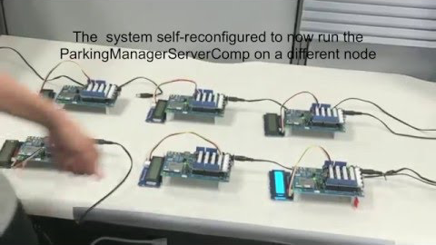

Slide 6
Okay. But what is a distributed system anyways.

Slide 7

What is a distributed system.
Before we can answer this, we need to recall somethings
What is a program?
What is a process?
What is a thread?
What is inter-process communication?
Why do we want to run programs on different computers?
Better resource scheduling
Less likelihood of simultaneous failures (this require assumption of no common mode failures – we will discuss this in detail later)
Perhaps we can do tasks efficiently if we are closer to data.

Slide 8
Two properties of a distributed system
Spatial separation
Temporal separation

Slide 9
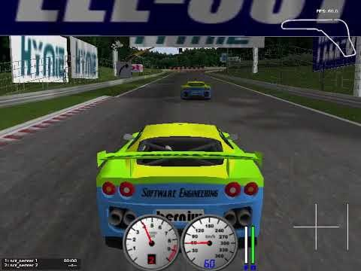

Slide 10
Distributed Systems /Internet of Things – Why it Matters?

Slide 11

Smart Building – Operational Efficiencies

Slide 12


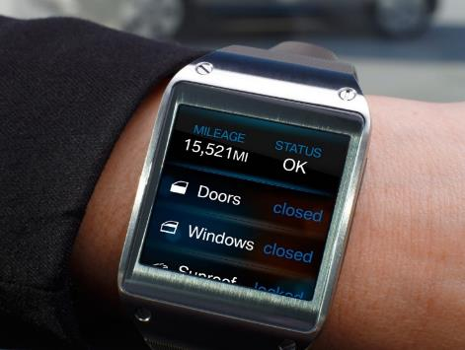
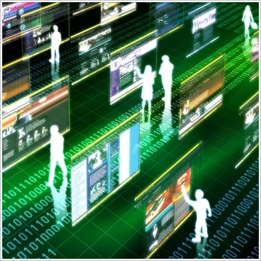
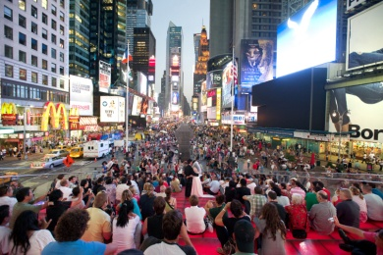
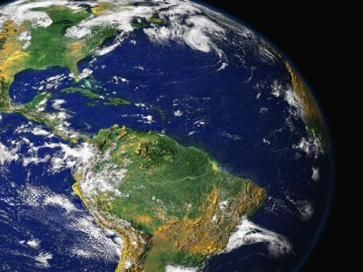
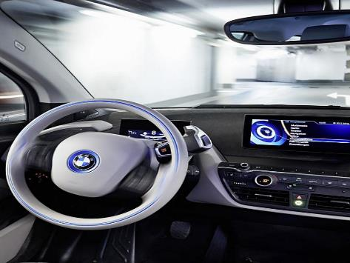

Integrated Internet of Things is the New Megatrend
MEGATRENDS
Internet of Things
DEMOGRAPHIC CHANGE
CLIMATE CHANGE
ALWAYS ON
SHOPPING
URBANIZATION
GLOBALIZATION
SHARING ECONOMY
AUTONOMOUS DRIVING

Slide 13
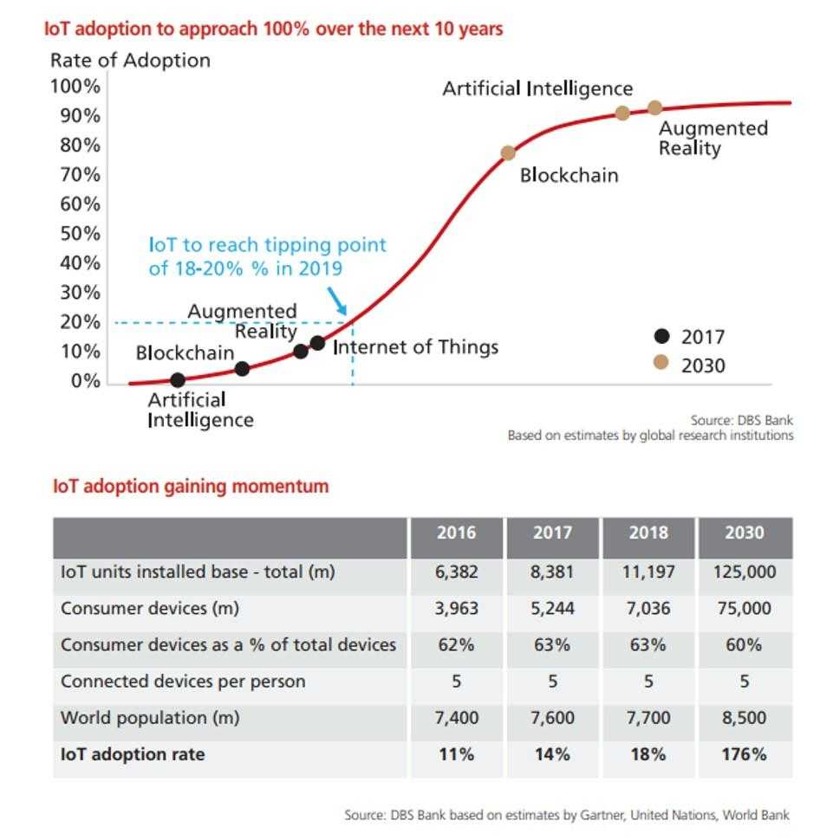
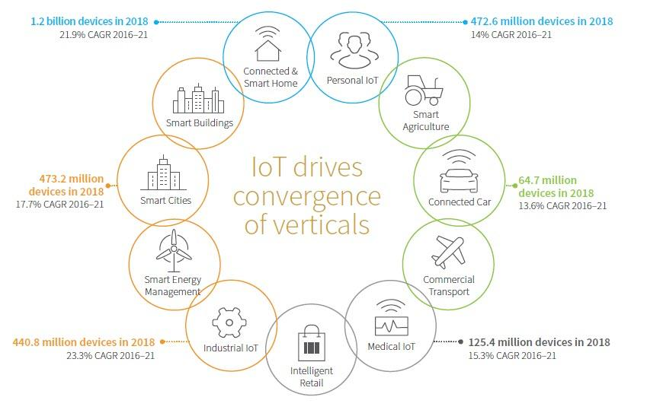
Integrated Internet of Things is the New Megatrend
SOURCE: IHS MARKIT, THE TOP TRANSFORMATIVE TECHNOLOGIES TO WATCH THIS YEAR, 2018 (PDF, 16 PP., NO OPT-IN).
IoT is generating Data that is responsible for the boom in Artificial Intelligence

Slide 14
We Are In The Midst Of The Fourth Industrial Revolution

Slide 15

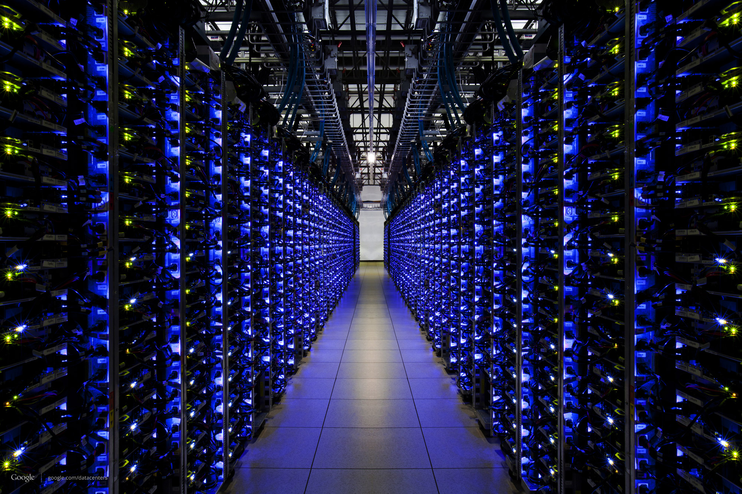
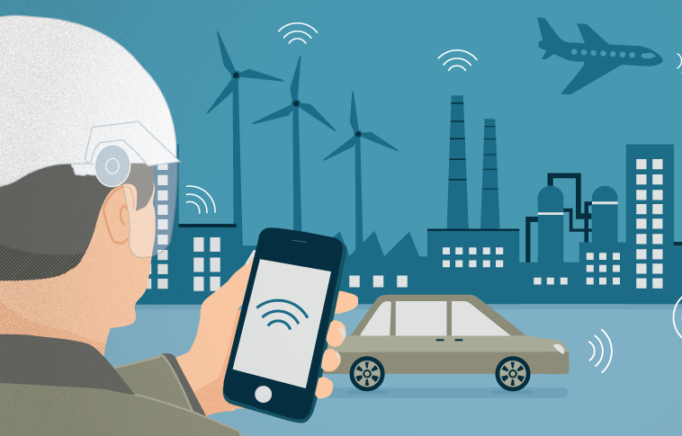

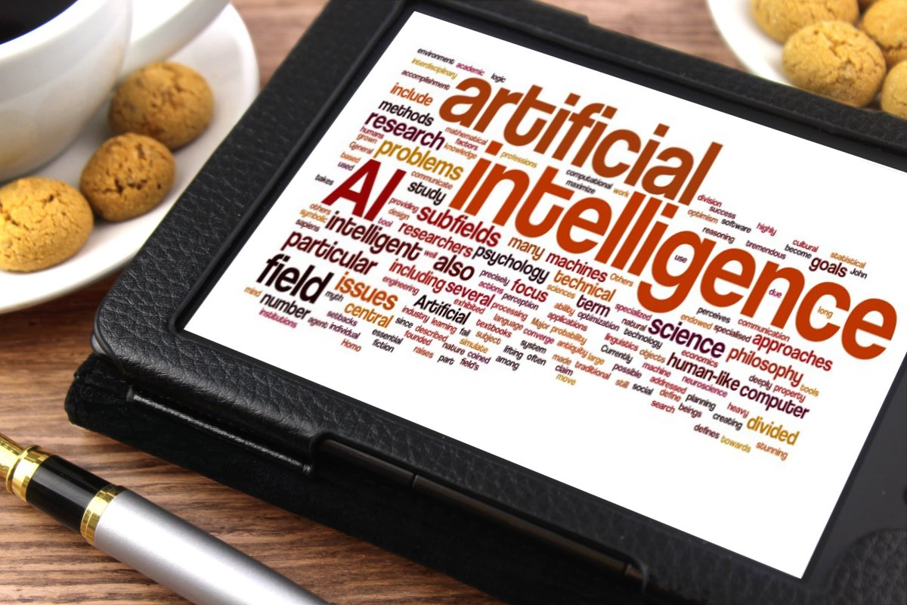

Facets of The Fourth Industrial Revolution
CYBER-PHYSICAL SYSTEMS
CLOUD COMPUTING
MOBILE COMPUTING
Picture 4
SMART EMBEDDED SYSTEMS
Artificial Intelligence
SOCIAL COMPUTING & COLLABORATION
Picture 5

Slide 16
Example 1 – Smart Transportation Systems

Slide 17

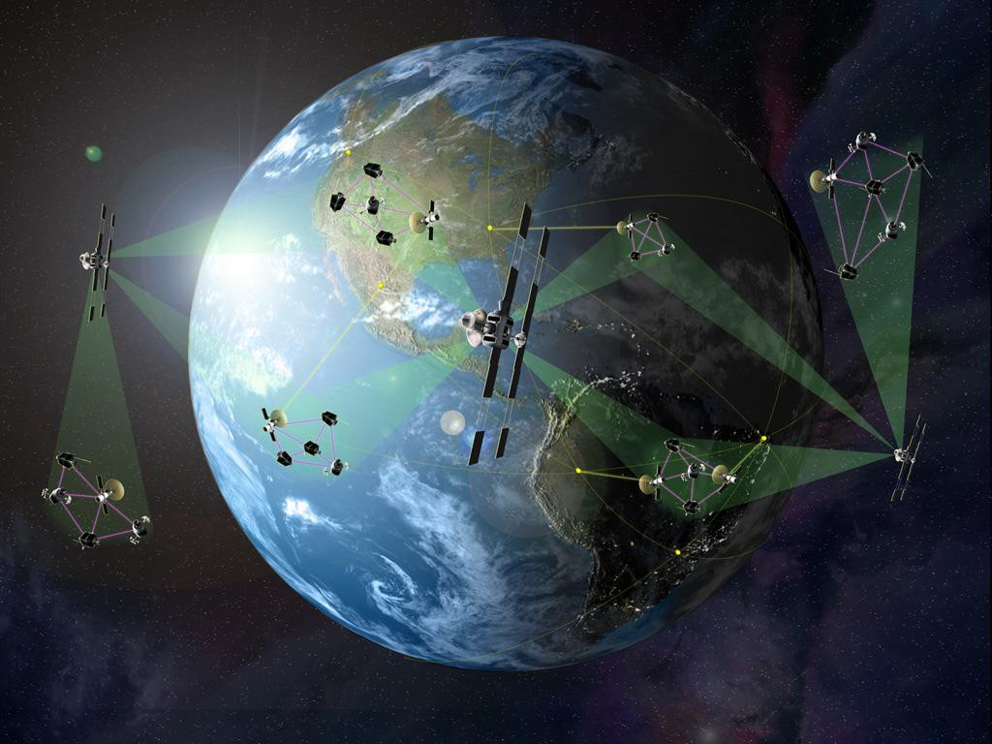
Example 2 – Smart and Connected Satellites
Domain: Cluster of communicating satellites – cloud computing in space
Objective: To build a robust, reliable software ‘operating system’ to be a wide variety of networked applications for space-based sensing, communication relays, and other missions
Results: Design and prototype software implementation

Slide 18
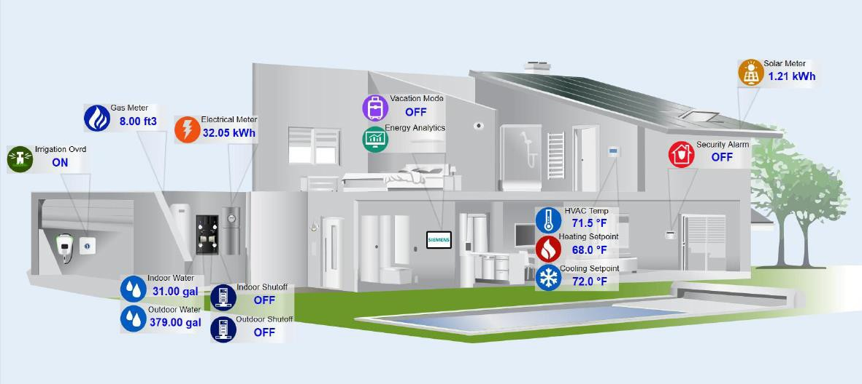
Example 3 – Smart and Connected Homes
P2P Energy Trading in a Microgrid
Conv entional
energy market
Energy Retailer, or DSO
Energy demand and surplus.
TM
TM
TM
P
P
TM
PETra
TM
P
TM
P
Energy Exchange Reduces Dependence on the Grid
P
TM
P
TM
TM
P
P
TM
Information privacy
TM
Transactive Meter
– energy assets, anonymous addresses, and mixing services
Assuring integrity and auditability of finalized transactions
– distributed ledger and tamper proof smart meters
Decentralized Market Mechanism
– Hybrid integration of MILP solvers and smart contracts

Slide 19
Example 4 - Smart Building Management

Slide 20
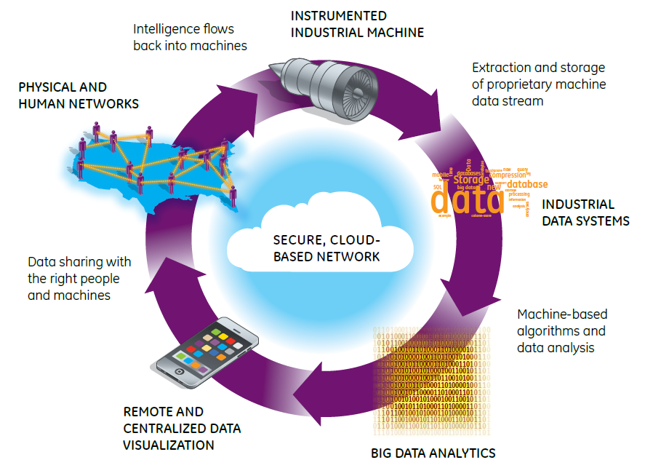

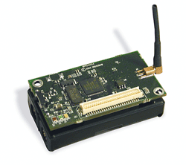

Deconstructing Smart IoT Systems
Human Layer
Environment
Sensors
Smart Application Layer
Computation Platform Layer
Networking Layer
Physical System and Sensors

Slide 21
Deconstructing Smart IoT Systems
Human Layer
Environment
Sensors
Data Streams
Smart Application Layer
Computation Platform Layer
Platform
Networking Layer
Physical System and Sensors

Slide 22
Deconstructing Smart IoT Systems
Human Layer
Environment
Sensors
Data Streams
Smart Application Layer
Decision Support Systems
Platform
Networking Layer
Physical System and Sensors
Decision Support Systems: Big Data Analytics

Slide 23
Deconstructing Smart IoT Systems
Human Layer
Environment
Sensors
Data Streams
Smart Application Layer
Decision Support Systems
Platform
Networking Layer
Physical System and Sensors
UI and Information Presentation
Decision Support Systems: Big Data Analytics

Slide 24
Deconstructing Smart IoT Systems
Human Layer
Environment
Sensors
Human Networks
Data Streams
Smart Application Layer
Decision Support Systems
Data Sharing
Platform
Networking Layer
Physical System and Sensors
UI and Information Presentation
Decision Support Systems: Big Data Analytics

Slide 25
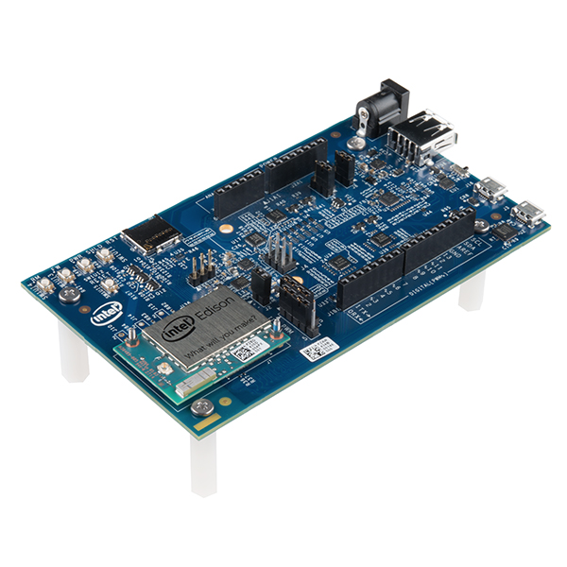
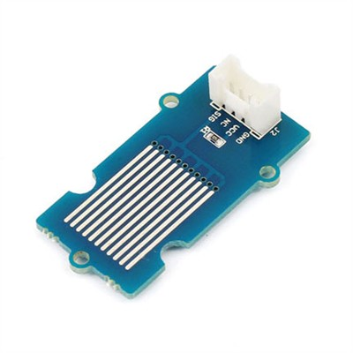
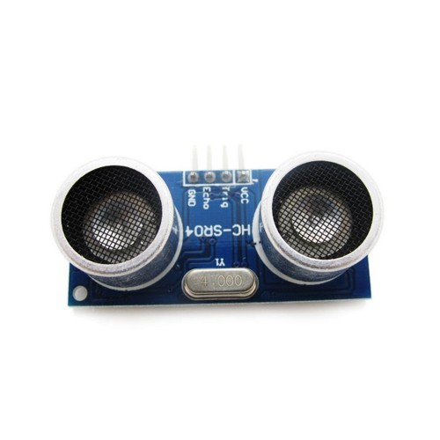
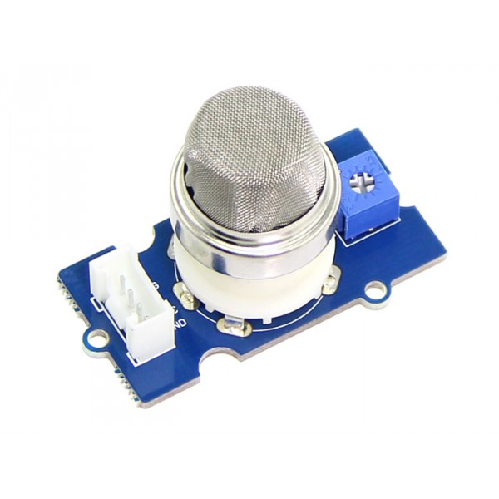
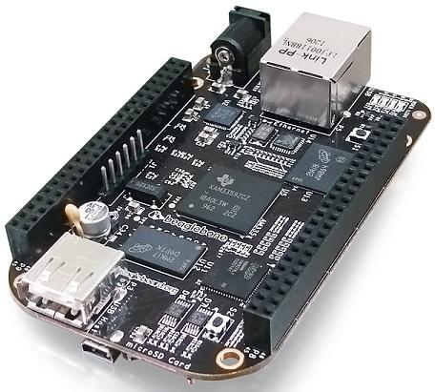
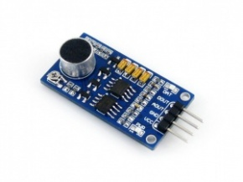
Physical System and Sensors
Human Layer
Smart Application Layer
Decision Support Systems
Networking Layer
IoT sensors have rapidly improved in performance and have reduced in cost
Physical System and Sensors

Slide 26
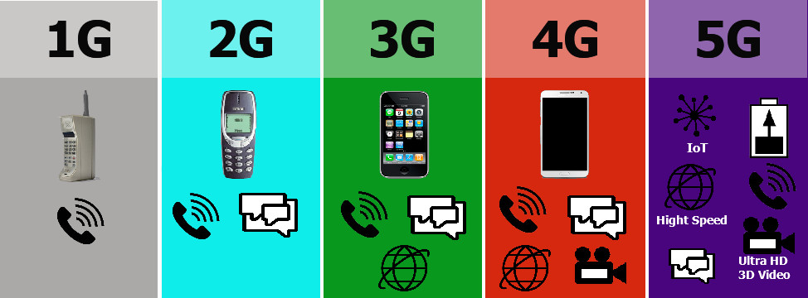

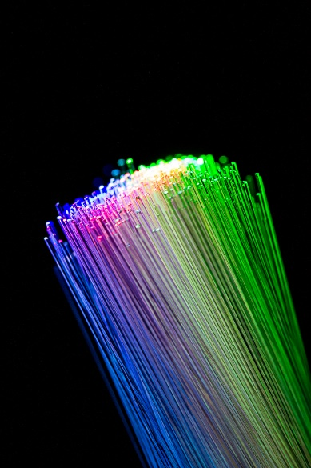
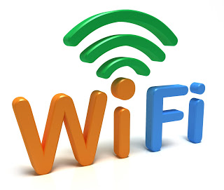
Networking Layer
Human Layer
Smart Application Layer
Decision Support Systems
Networking Layer
Physical System and Sensors
The data from the IoT Sensors have to be moved in real-time to a computation backend for analysis.
Must deal with a range of networking technologies
The tradeoff is between throughput, cost, and timeliness and reliability of data transfer

Slide 27
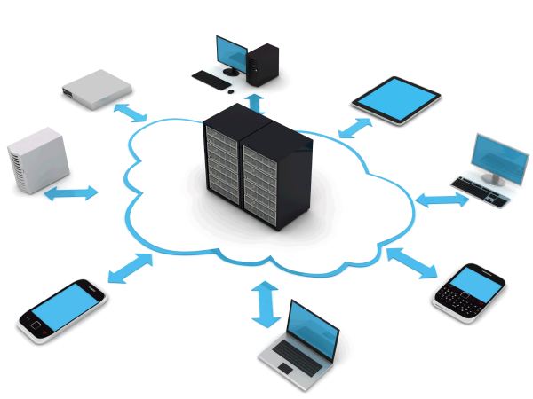
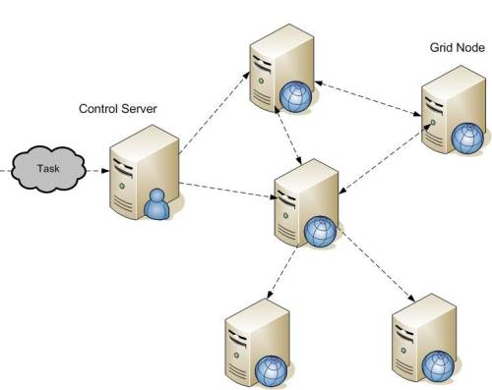
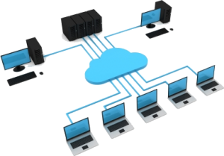
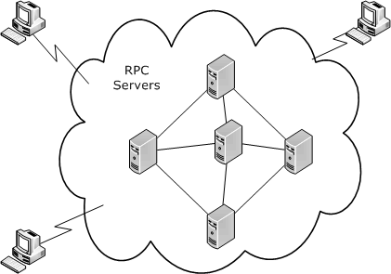
Decision Support Systems/Computing Layer
Human Layer
Mobile computing
Smart Application Layer
Grid Computing
Present
Decision Support Systems
Late 2000s
Edge Computing
Networking Layer
Mid 2000s
Physical System and Sensors
Mid 1990s
Cloud Computing
Small Homogeneous Clusters

Slide 28


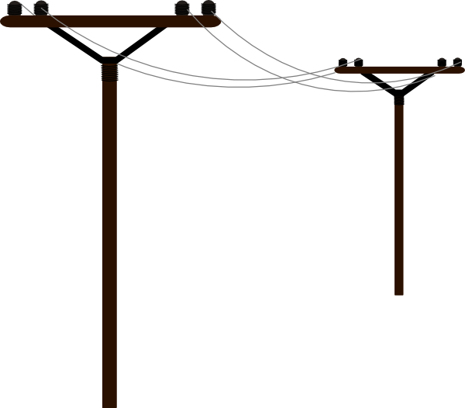





Decision Support Systems/Computing Layer
Human Layer
Handle the velocity and volume of data flows
Establish and implement Security Constraints
Ensure Timing Constraints
Maintain Reliability
Cloud
Resource availability
Smart Application Layer
Decision Support Systems
Fog
Networking Layer
Data source proximity
Physical System and Sensors
Edge (Sensors, Actuators)
The computing layer tradeoff is between latency, reliability and cost

Slide 29





Smart Application Layer
Human Layer
Smart Application Layer
Decision Support Systems
Networking Layer
Physical System and Sensors
The Smart Application Layer enables the construction of the IoT Applications

Slide 30
Human Layer
Human Layer
Smart Application Layer
Decision Support Systems
Networking Layer
Bad User Interface - Dilbert Comic Strip on 2018-05-02 | Dilbert by Scott Adams
Physical System and Sensors
Visualization is one of the most critical factor responsible for success/failure of these devices

Slide 31
Next Lecture
We are going to review the fundamental concepts of networking.
There is a reading materials on sockets and internet routing in the repository. Please prepare before the next class.

